Slide 1

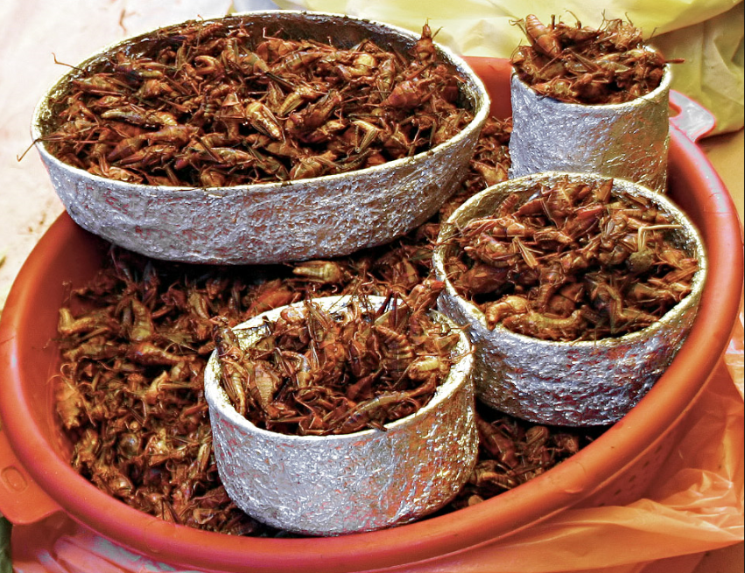
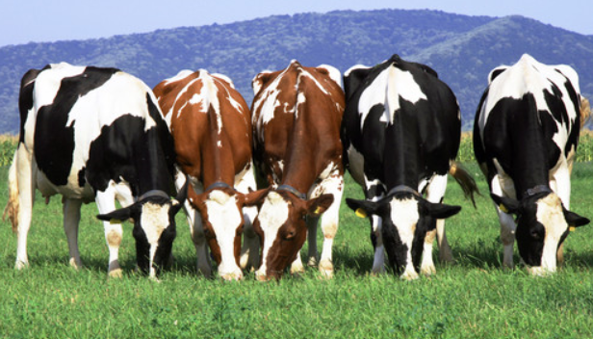
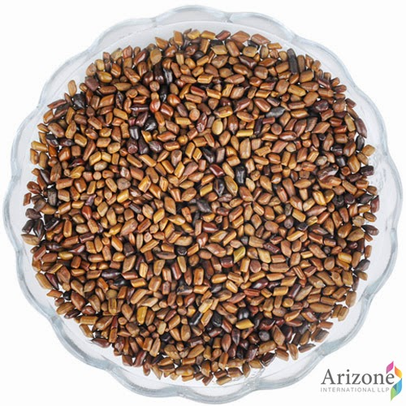
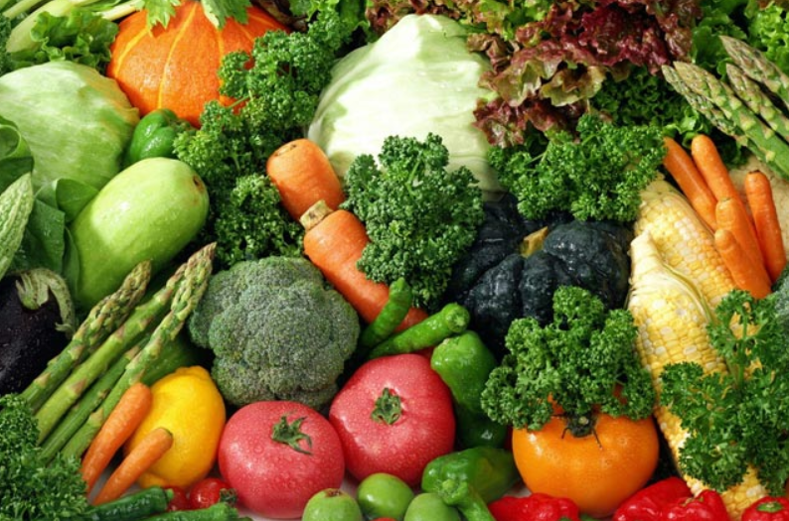
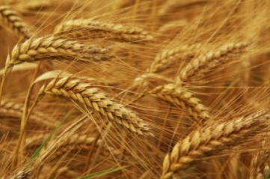
DAPP Integrates Food, Nutrition, and Public Health in a Rapidly Changing Environment

Slide 2

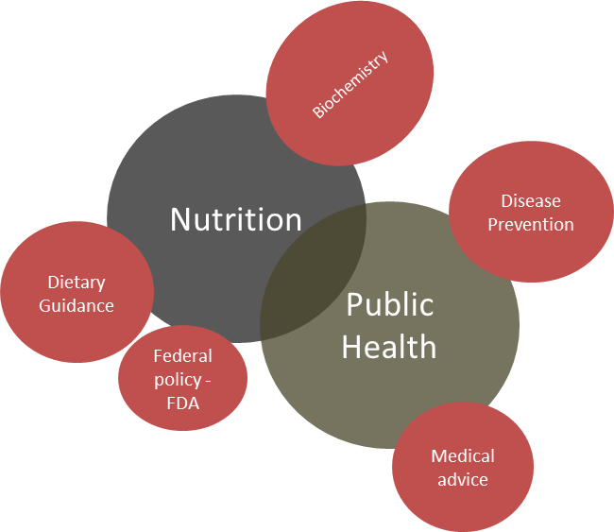
Economics
Production
system
“The Canyon” – Nutrition,
Production Ag and Public Health have lost their connections
Plant -animal health
Agricultural Production
Genetics
Sustainability
Food Industry - Product Development
Harvest -
Processing
The focus of academia and research effectively widens the gap

Slide 3
How did we get to “Dairy Agriculture for People and the Planet” (DAPP)?
Proof of principle-2017: DAWG experiment to include nutrition data and NUOnet infrastructure for data management and sharing
Objective: Develop agronomic and animal management practices in the dairy industry for delivery of products that are nutrient dense and positively impact public health, but with a lower environmental impact.

Slide 4
Key elements
Communication
Communication
Communication

Slide 6
Pilot Dairy Cow Feeding Study
Conducted at the U.S. Dairy Forage Research Center in Madison and Prairie du Sac, WI.
Part of an experiment designed to evaluate whether cows maintain their efficiency when switching from a high starch diet to a less human edible diet (high fiber-low starch) and vice versa.
The study was a crossover design starting with a pre-treatment period of 4.5 weeks where all cows were fed a common diet, followed by 2 experimental periods where cows were fed one of the treatment diets for 8.5 weeks followed by the opposite diet.
Milk samples were taken on 2 consecutive days during each of the periods.

Slide 7
Pilot Dairy Cow Feeding Study
 | High starch | Low starch
Ingredients (%DM)
BMR corn silage | 24 | 33.6
Alfalfa silage | 24 | 33.6
High moisture corn | 24.5 | 0
Canola meal | 9.7 | 2.6
Soybean roasted | 4 | 4
Beet pulp | 2.7 | 8.7
Corn distillers grains | 2.6 | 9
Soybean hulls | 6 | 6
Minerals | 2.5 | 2.5
Nutrient (%DM)
DM (%) | 50.5 | 45.5
CP (% DM) | 16.1 | 16.5
NDF (% DM) | 29.0 | 36.9
Starch (% DM) | 27.1 | 12.9

Slide 8
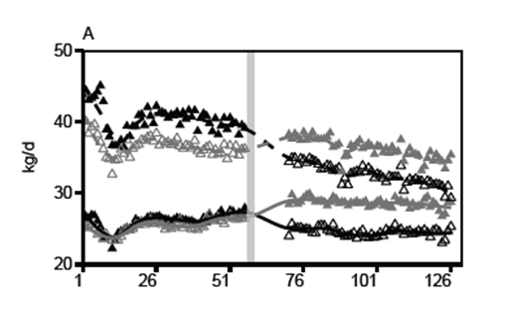
Pilot Dairy Cow Feeding Study
Milk yield (dashed line) and DMI (solid line) over both experimental periods.
represents low starch diets, represents high starch diets.

Slide 9
Challenges
Six milk samples were taken from each animal at each sampling time and samples were sent to 4 different labs for analysis.
Future experiments will connect soil measures and forage production to animal feeding studies.
Challenges will include separate forage harvesting and storage from the rest of the forages used in the herd diet.
Another challenge will be to connect each research area to the next so that data is accessible from soil to dairy product composition.

Slide 11
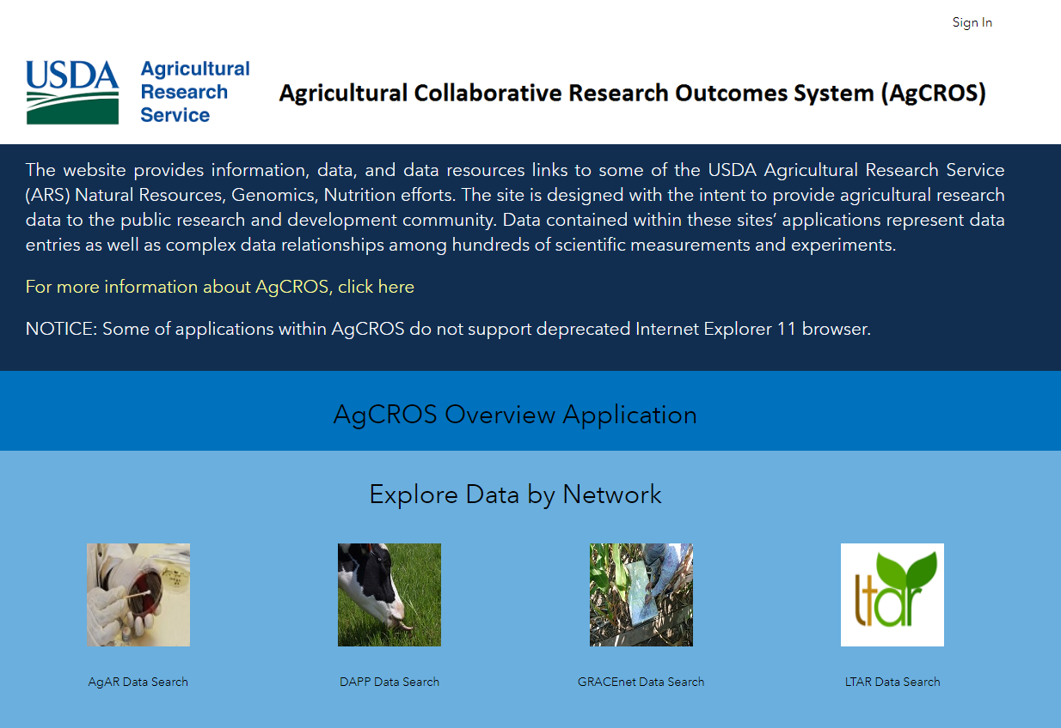
Data Management
Released in August 2018.
A partner with National Agricultural Library.
Built on Environmental Systems Research Institute (ESRI) technology. ESRI is the worldwide leader in GIS.
System is housed on Microsoft Azure cloud.
Part of a larger geoinformatics system which will include ties to SCInet (Ceres HPC).
ESRI and Microsoft will also expand the system by adding machine learning, AI, and spatial analytics.
This is a public database with spatial/temporal capabilities.
Data in AgCROS is from many ARS projects. It includes data on greenhouse gas flux, soil biology, antibiotic resistance, environmental nutrients, crop production, animal, nutrition, and many others.
DAPP application shows the flow of data from field to table and represent great communication among all groups members.

Slide 12
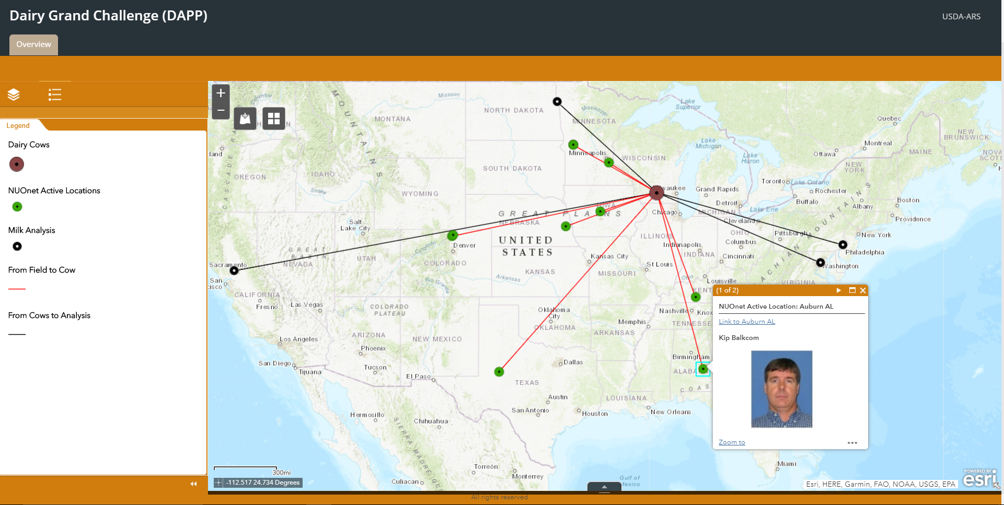
AgCROS DAPP Application

Slide 13
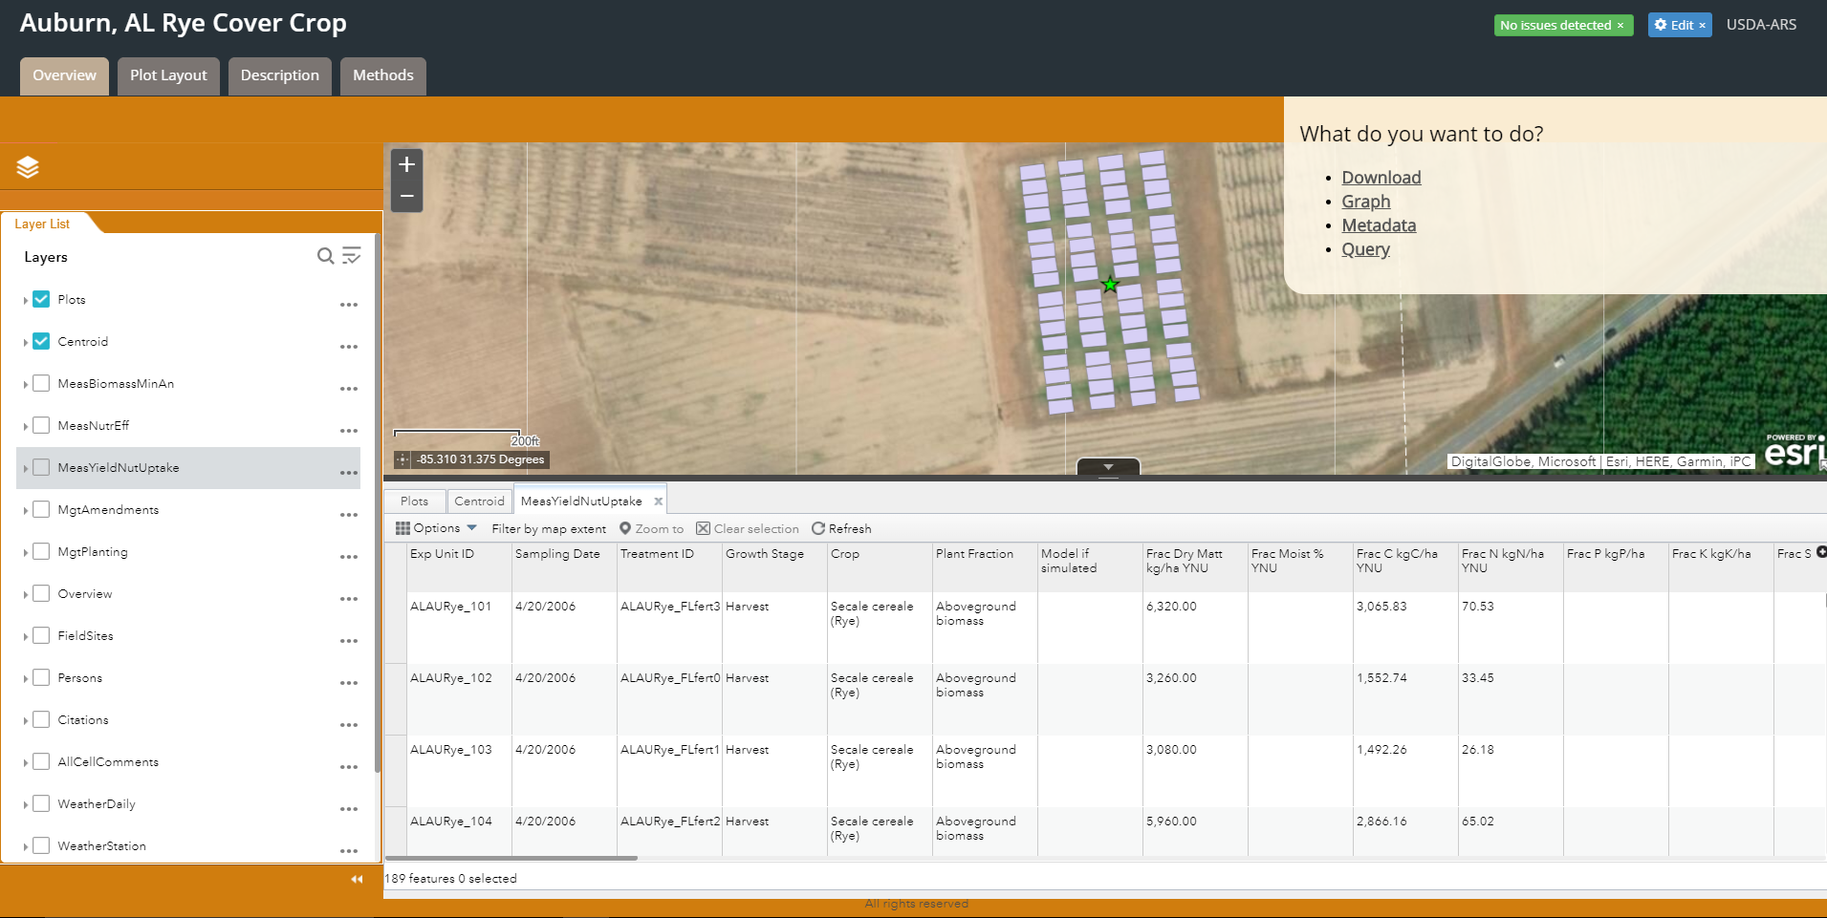
Nutrient Use and Outcome Network (NUOnet)
Table shows
yield nutrient
uptake for an
experiment in
Alabama.
Note: NUOnet
was not part of
first trials for
DAPP as it was
in development.

Slide 14
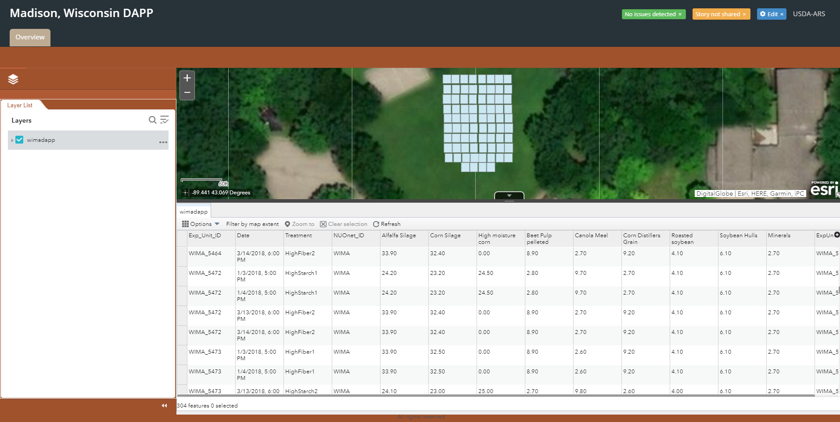
Dairy Experiment Animals
Table shows
the percent dry
matter of the
feed used for
first trials

Slide 15
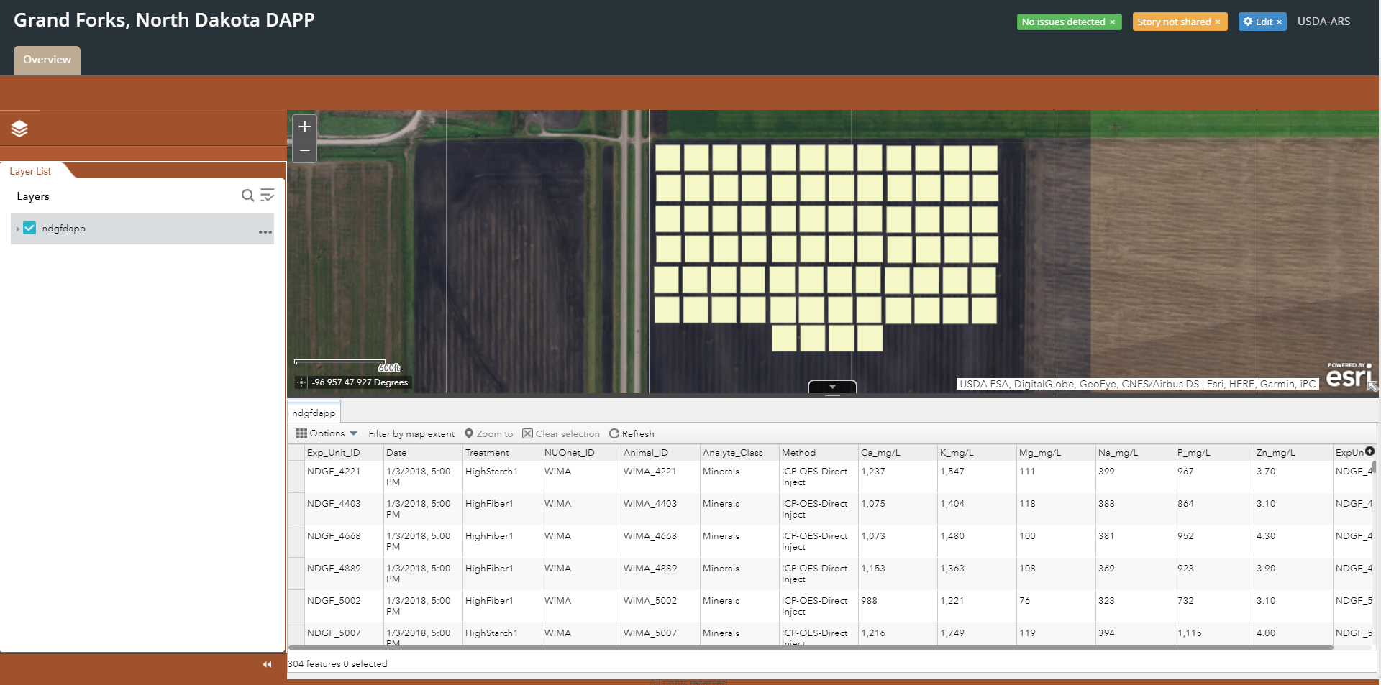
Milk Sample Analysis
Table shows
the mineral
analysis
of the milk from
each cow for
first trials

Slide 17
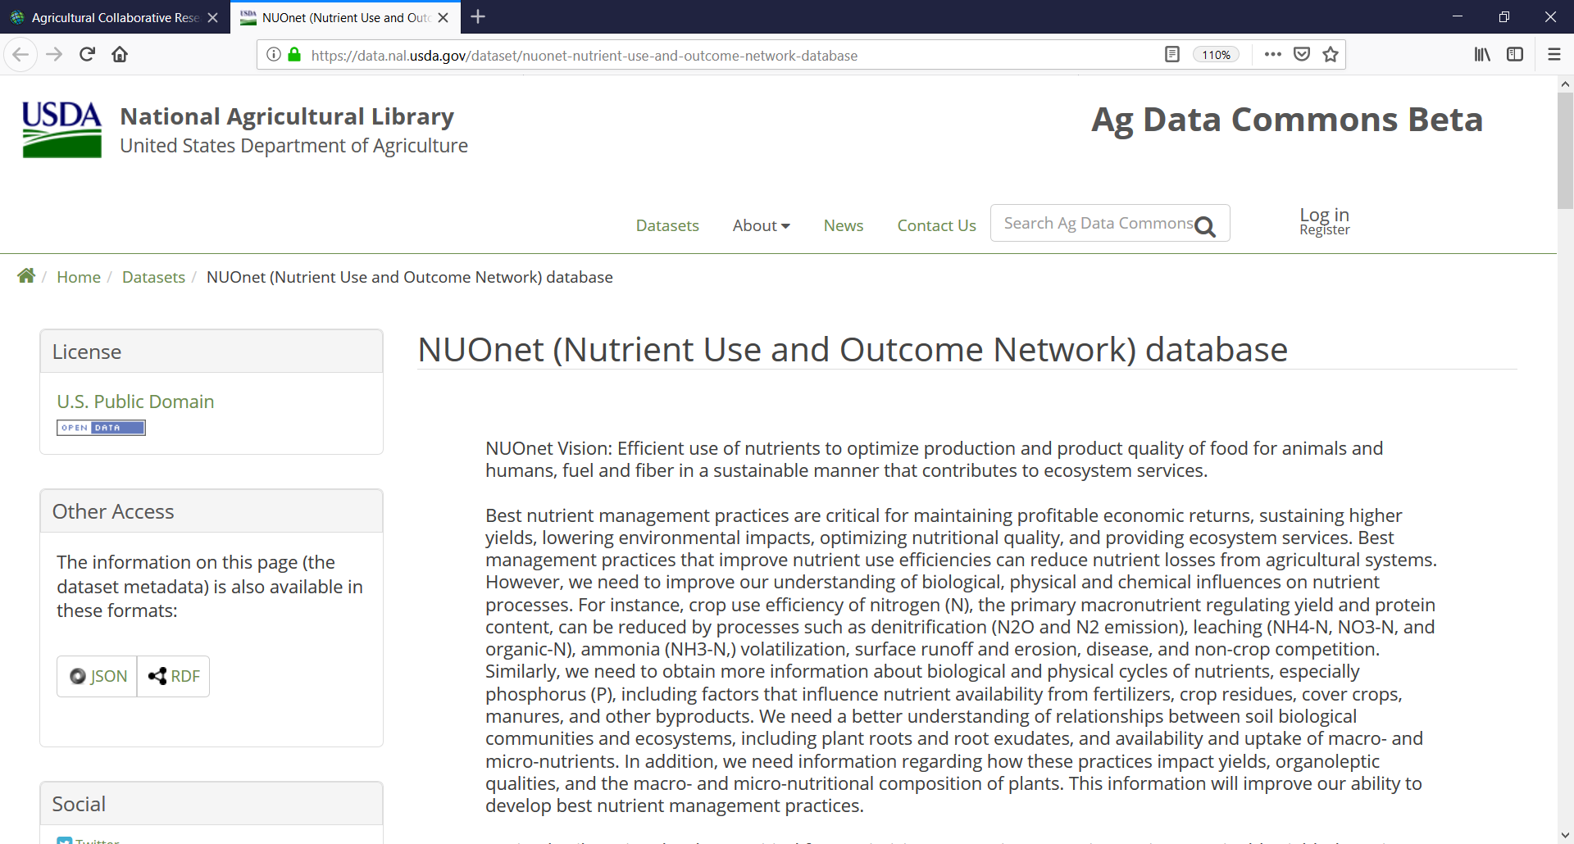
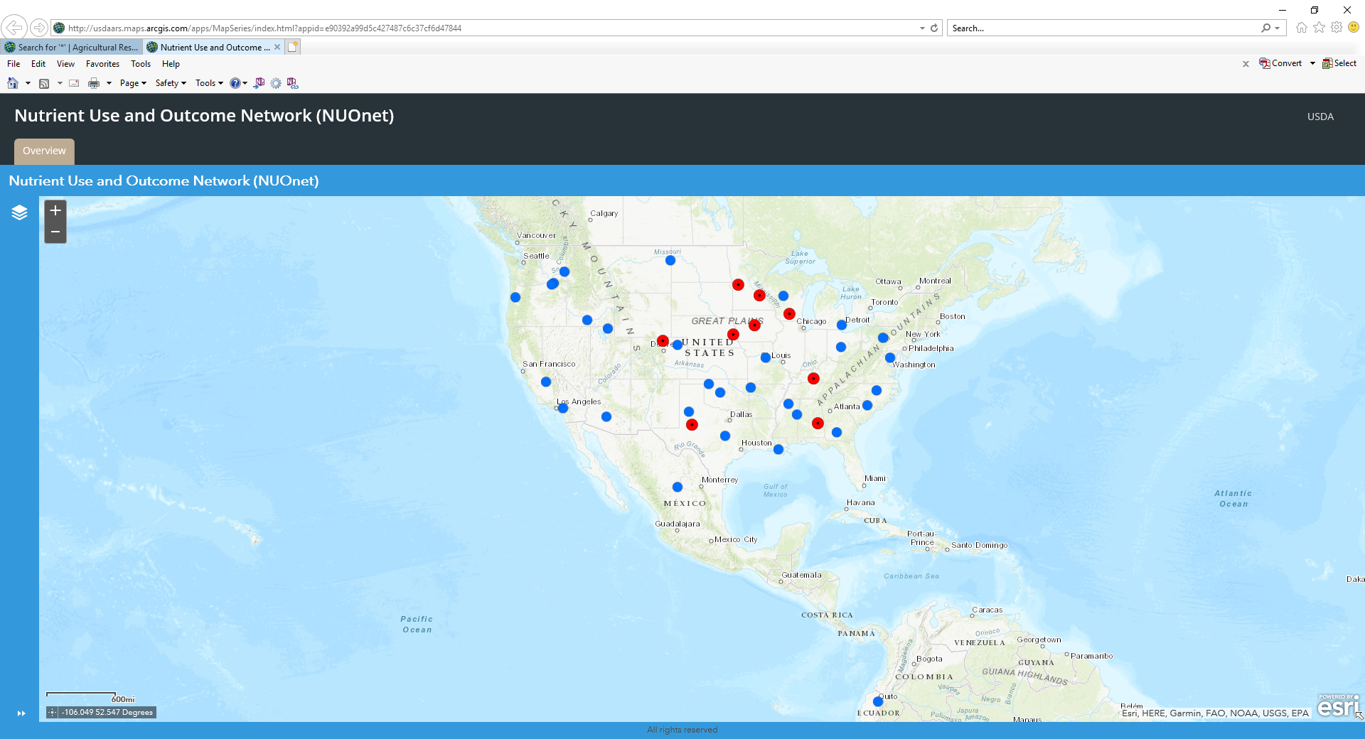
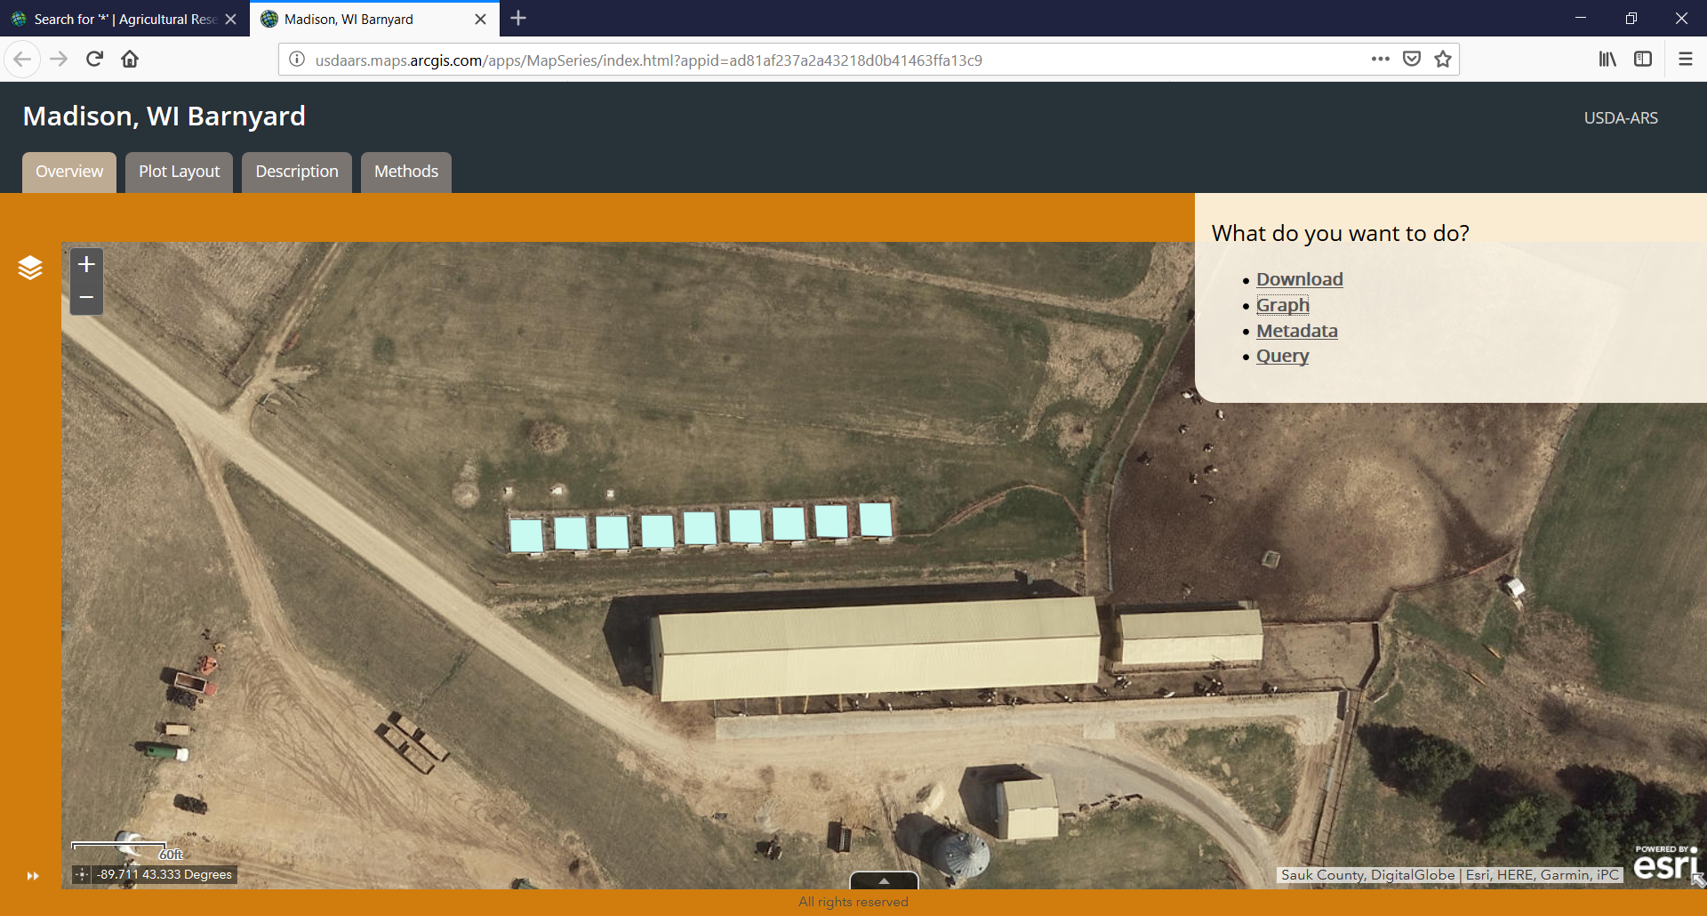
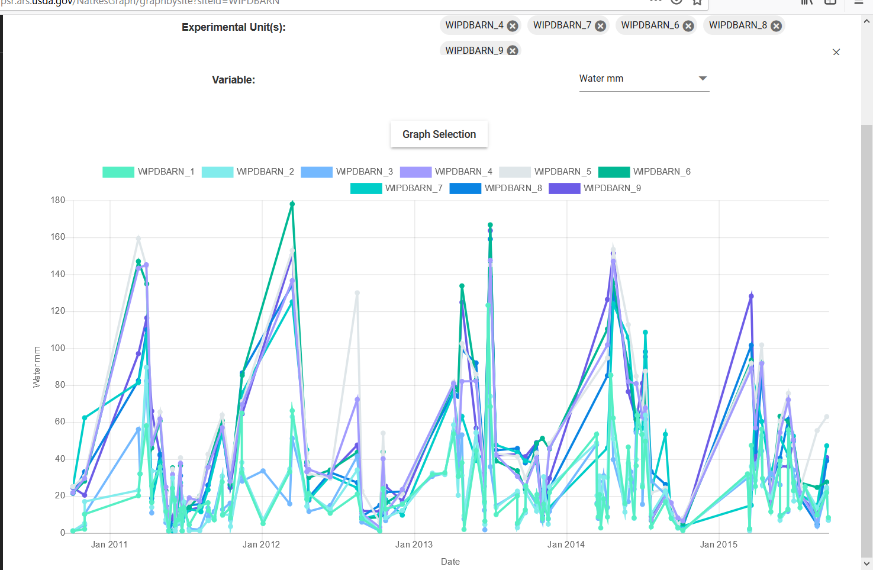
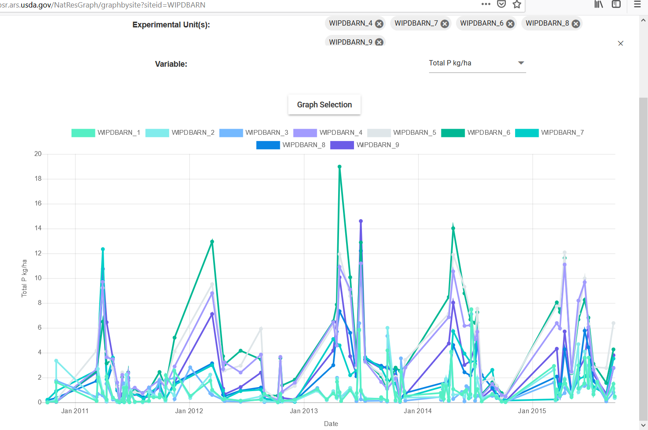
Impact: The proof of concept for the field component of the DAPP database efforts was released in the fall of 2018.
Wisconsin
GHG, nitrate leaching,
surface losses data
Water mm
Total P kg/ha
Delgado et al. 2018. Agricultural Collaborative Research Outcomes System (AgCROS): A network of networks connecting food security, the environment, and human health. J. Soil Water Conserv. 73: 158A-164A.
Notes:
This includes, among other accomplishments, the development of procedures, data quality checks, the NUOnet DET, webpage, etc. As we move forward, this will be adapted as needed to connect DAPP research data from the field to the table (see NUOnet example below).

Slide 18
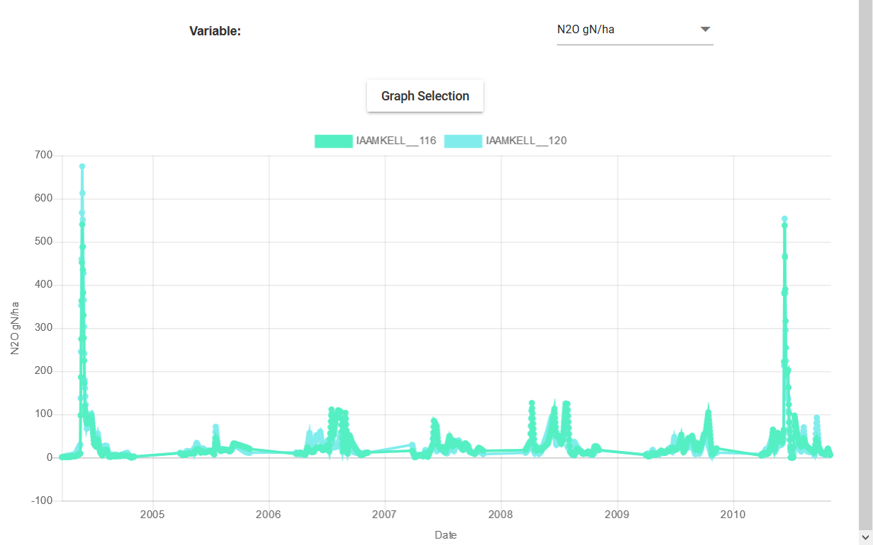
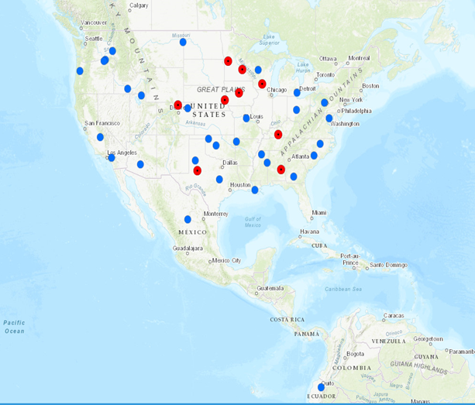
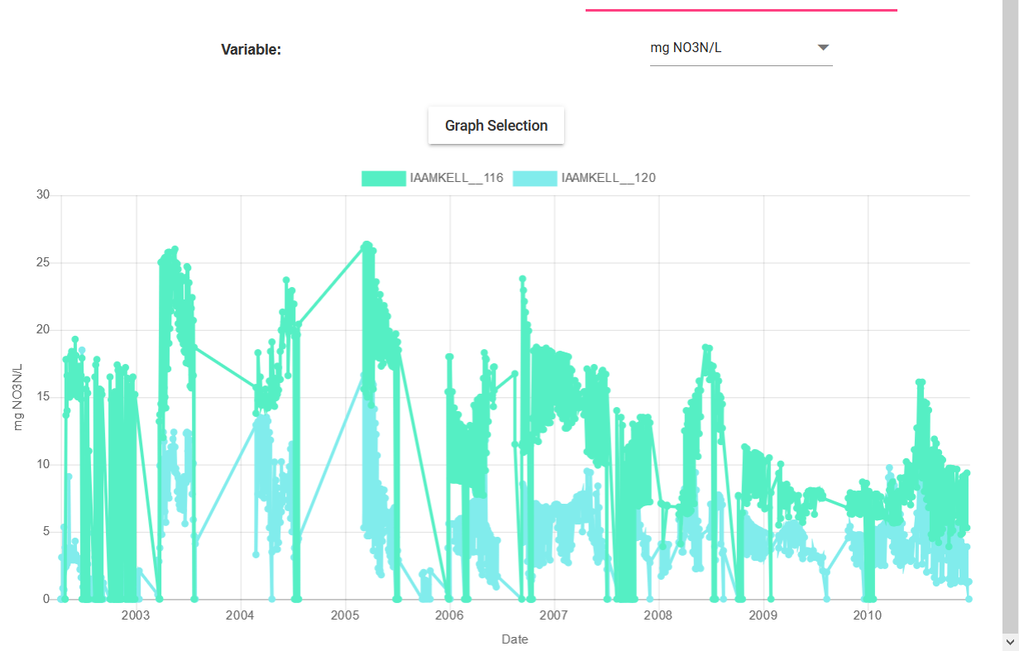
Impact: The proof of concept for the DAPP-NUOnet effort is strengthening other databases such as GRACEnet and REAP (see NUOnet example below).
In the USA about 78% of GHG emissions from agriculture are from reactive N₂O.
About 20% of these emissions are from indirect N₂O emissions resulting from NO₃-N leaching, NH₃ volatilization and other N loss pathways.
Databases such as GRACEnet and REAP do not collect this type of data.
With the addition of NUOnet, we now have an ARS database system that provides more complete information about direct and indirect N₂O emissions.
N₂O g N/ha
mg NO₃ N/ha
Iowa
GHG and nitrate leaching
(observed and modeled) data
Notes:
This information could be used for fine-tuning models used for greenhouse gas (GHG) inventories.
Other nutrient loss pathways which were not being accounted for in other databases, such as loss or deposition of organic carbon, are now included via NUOnet.

Slide 19
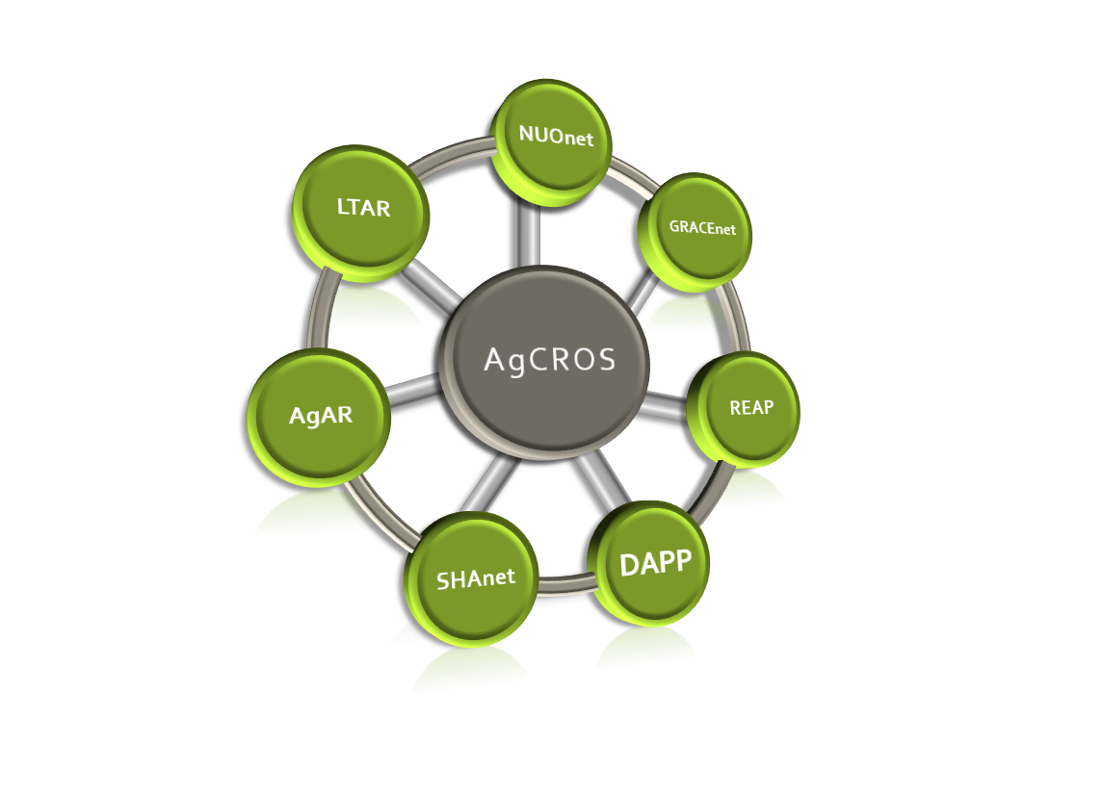
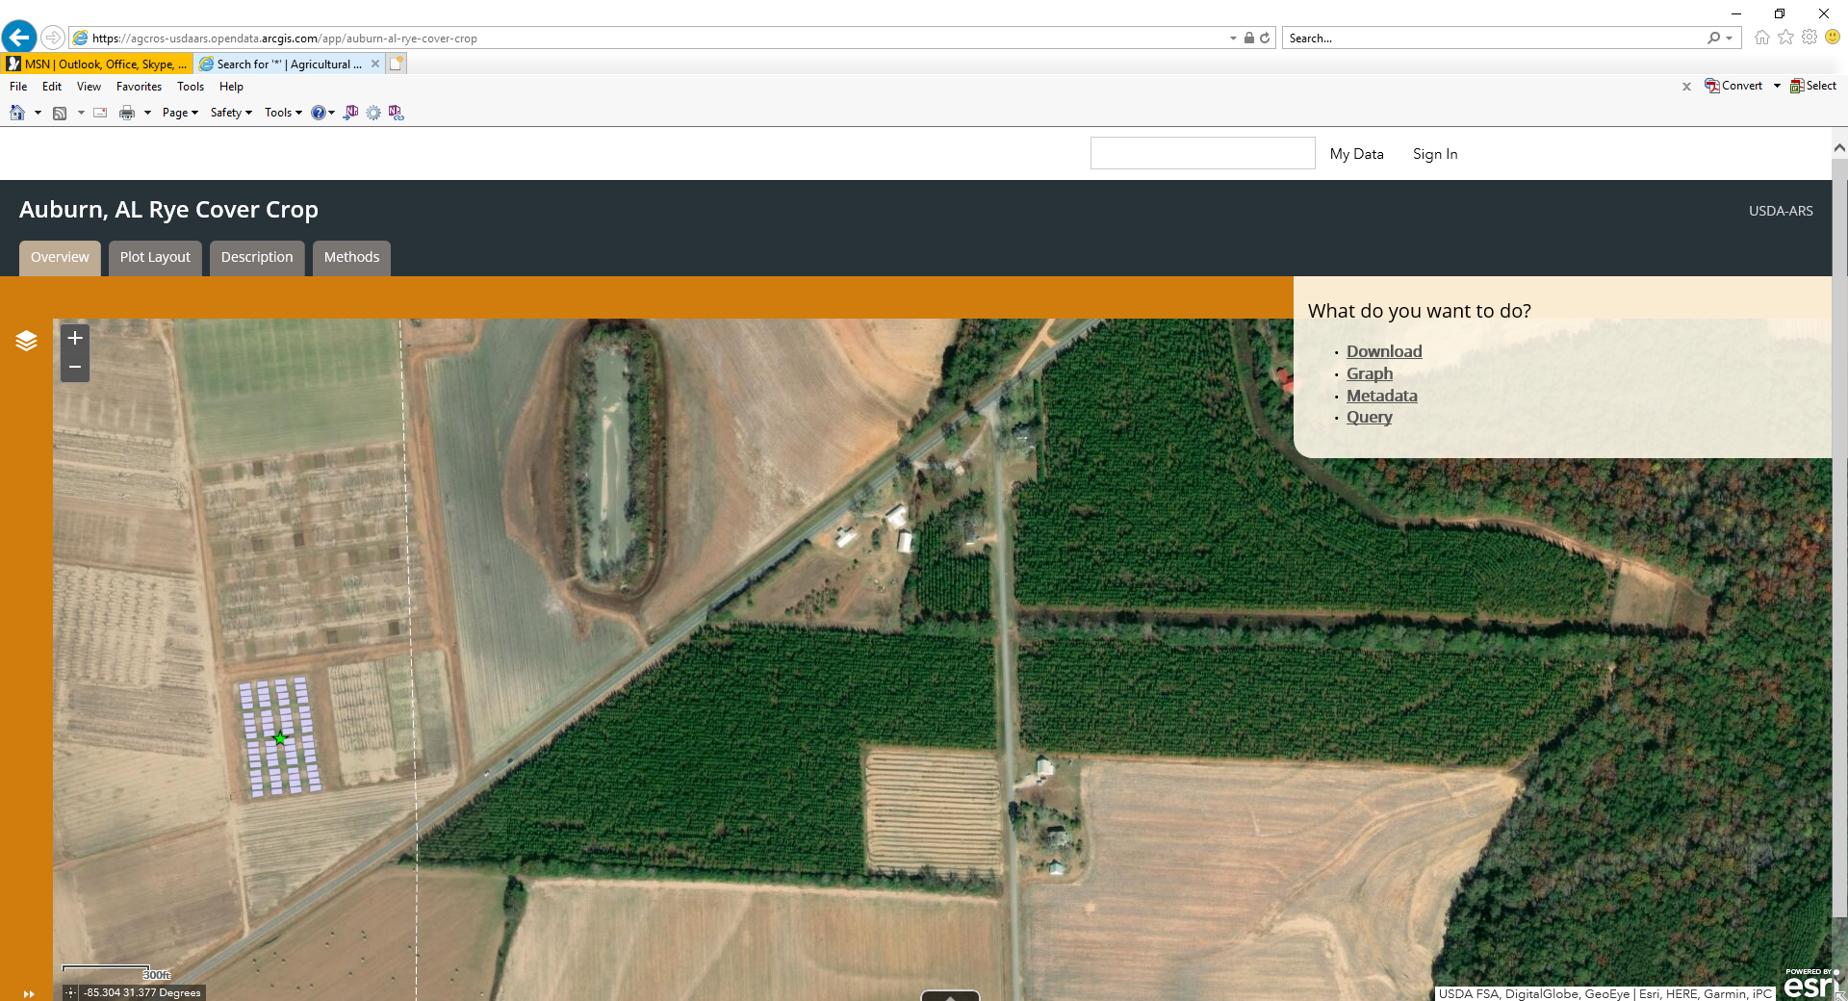
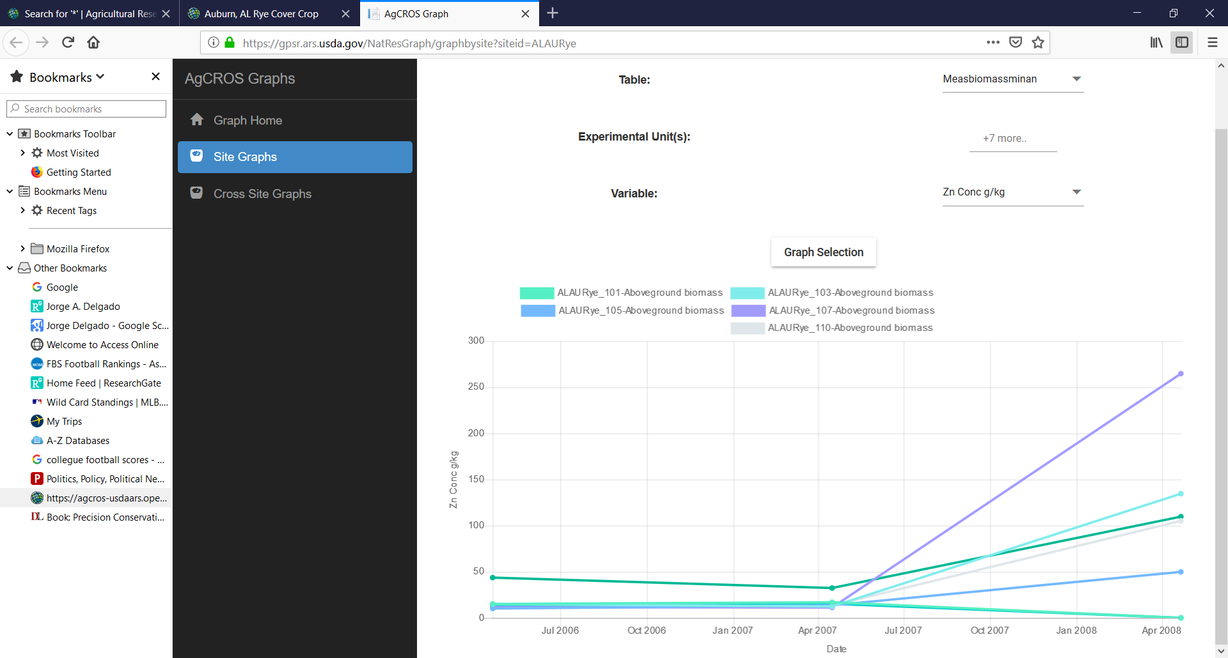
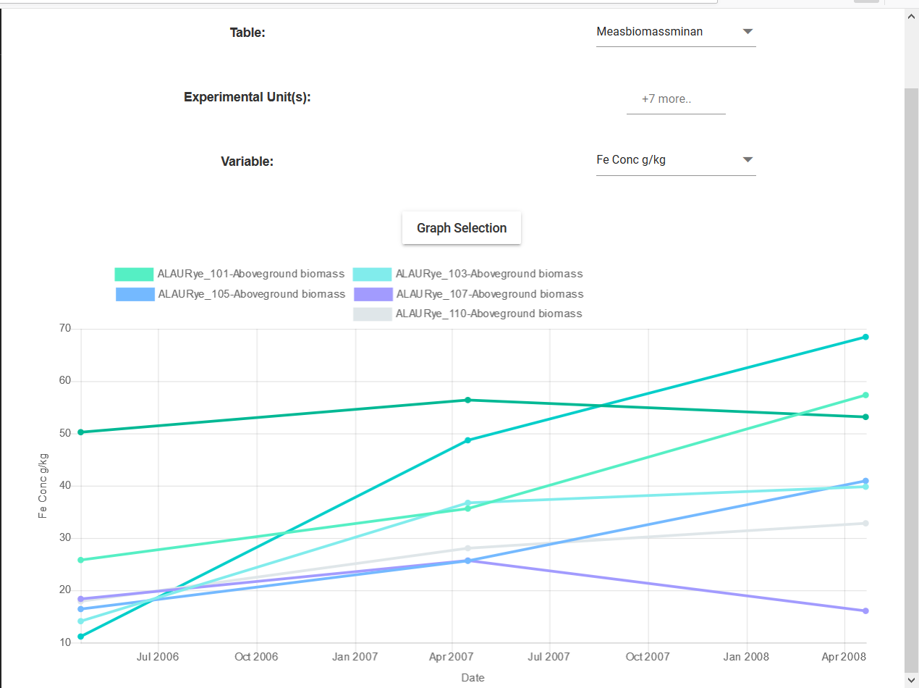
Impact: The DAPP-NUOnet proof of concept released in the fall of 2018 using the framework of GRACEnet/REAP facilitates the communication and exchange of information across different databases, and is facilitating efforts to connect data from the field to the table.
The next step is the development and implementation of a field project to collect information about the impact of BMPs that have the potential to reduce environmental losses, provide improved forages to livestock, and improve milk quality and human health. Results could be entered into AgCROS DAPP.
Zn g/kg
Fe g/kg
Alabama
Cover crops, nutrient data
Delgado et al. 2018. Agricultural Collaborative Research Outcomes System (AgCROS): A network of networks connecting food security, the environment, and human health. J. Soil Water Conserv. 73: 158A-164A.

Slide 21
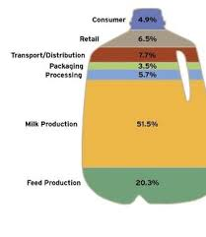
Agricultural Production Processing Nutrition
Quality, Safety and Nutrition
Data too numerous and is missing from LCAs, needs to be correlated or predicted*
US Fluid Milk Carbon Footprint
GHG emissions small compared to
preharvest GHG:
Processing affects milk component
interactions which affect nutrient
densities and structure.
Think: milk cheese cream butter
Digestion of the structured foods
may affect breakdown into
peptides, fatty acids, and other
components and affect
absorption
Heat affects components
Homogenization reduces fat sizes
Separation controls fat levels
Filtration separates proteins
with many more processes to
consider.
217.575 B LBS (25.3 B GALS) produced in 2018
*Tomasula et al. 2013 Computer Simulation of Energy Use, Greenhouse Gas Emissions and Process Economics of the Fluid Milk Process. 2013. JDS.96(5)

Slide 22
Flow Sheet of the Fluid Milk Process by SuperPro – Design and Data by Users
Raw Milk In
Pasteurized Milk Out
CIP
Wastewater Treatment
CIP

Slide 23
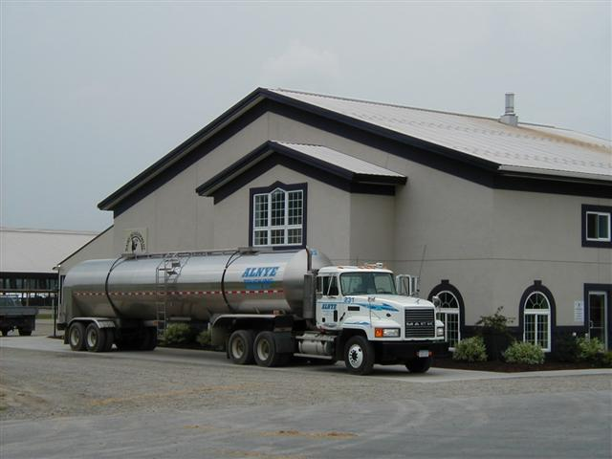
Model by section – Milk Storage
Simulation of Milk Cooling from Tanker to Balance tank
Milk is kept at or below1.8°C
Milk in tanker from one or more farms. Pumped into silo.
Mixed with milk from other farms. Microflora and compo-
sition is now that of the bulk silo.

Slide 24
Stakeholder Support is Critical for These Projects
Fluid milk is commodity milk and the majority of the stakeholder groups support all we do and are happy to give input to ensure impact.
They are not researchers, they are marketers. How will the research increase consumption of milk?
Communicate monthly. They support research the farmers and processors would support to increase economics, new information for label claims, and utritional benefits over other commodities.
Good sources for access to industry experts for input/consultation.

Slide 25
Next Steps
Put Nuonet through the paces.
How would a processor or other researcher use
NuoNet? How to use feed info, soil, and track into milk?
2. Communicate to group; introduce this to Stakeholders
The single cow approach correlates with working with
segregated herds on large farms.
(e.g.; cows of similar genetics, at same stage of lactation,
same diets, etc.) Will a quality trait be observed?
3. Will attempt to predict a milk composition and follow up
with ERRC milk process simulator.

Slide 26
DAPP Across ARS
Madison, Wisconsin
Fort Collins, CO
Wyndmoor, PA
University Park, PA
Beltsville, MD
Grand Forks, SD
Davis, CA

Slide 28

The REALITY of the food system
The image the public wants

Slide 29
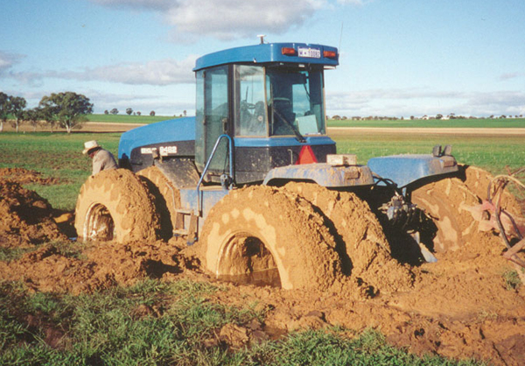
The REALITY the producer must deal with
SOLUTION: Transdisciplinary Research to feed the country and assure health of people and the planet

